Slide 1
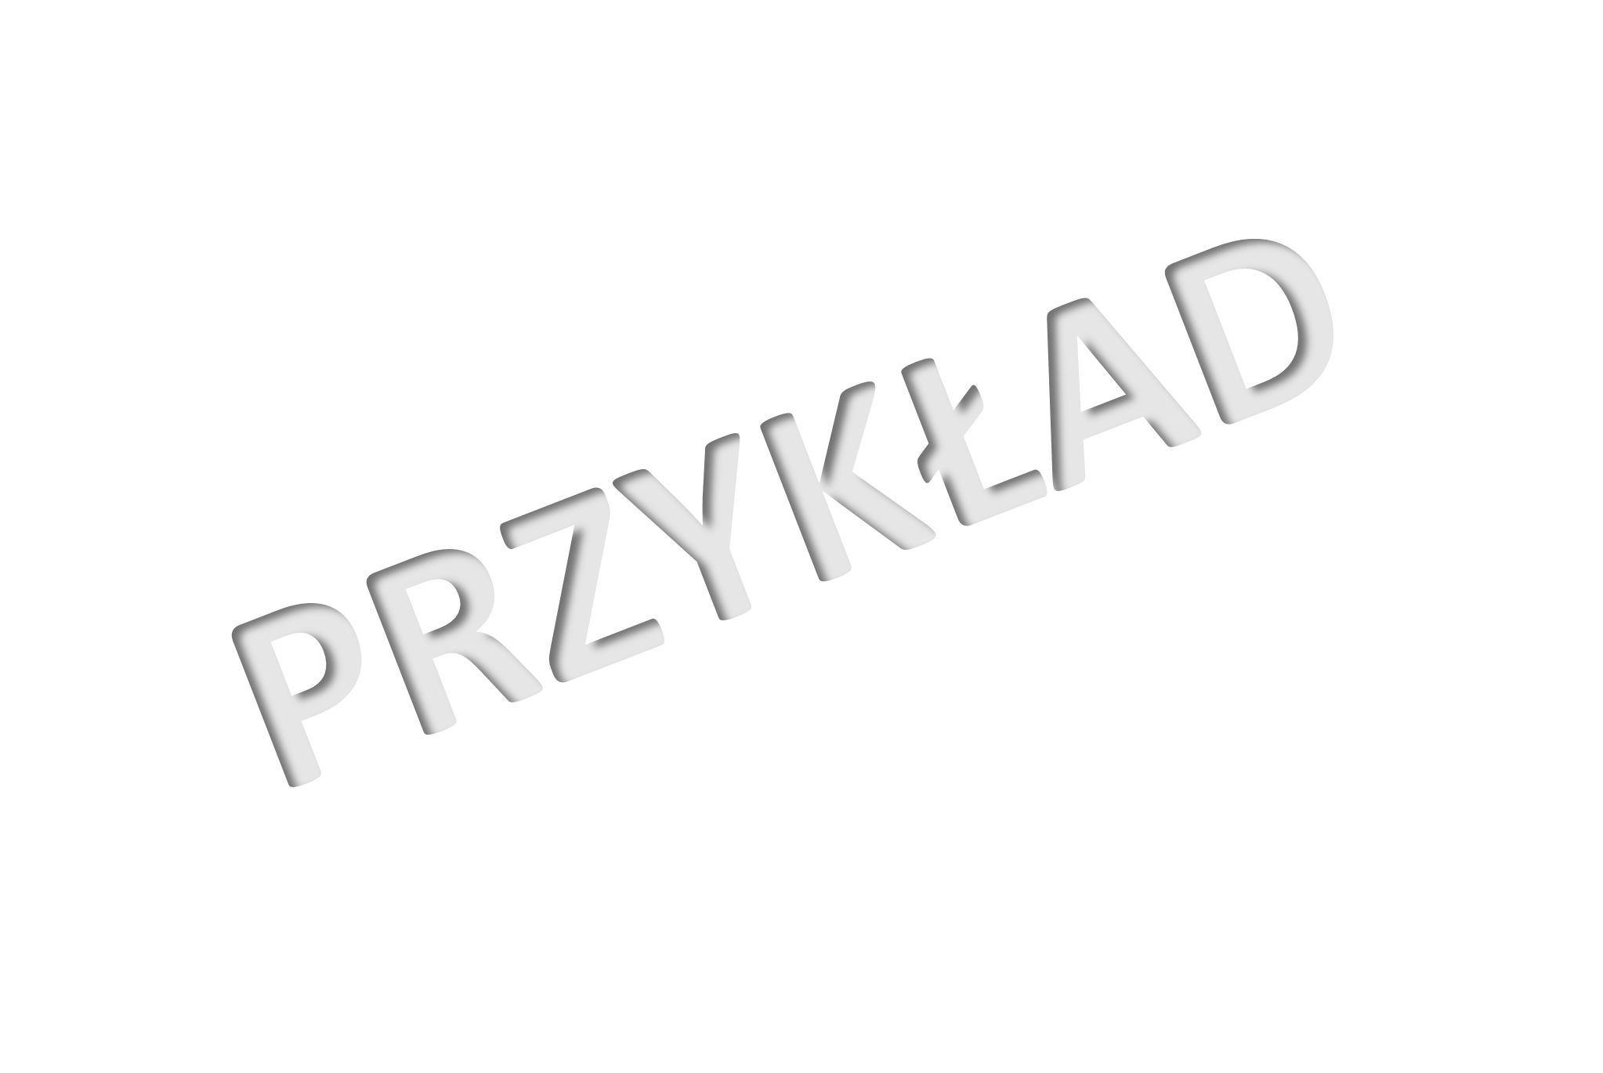
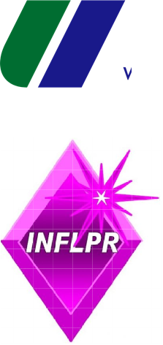
Solvent/non-solvent-based approach in MAPLE deposition of EVA coatings
A. Niemczykª, A. Piegat^{b}, S. Brajnicov^{c}, V. Satulu^{c}, A. Bonciu^{c}, J. Słowikª, J. Baranowskaª, B. Mitu^{c}, M. Dinescu^{c}
a Department of Materials Technology, Faculty of Mechanical Engineering and Mechatronics, West Pomeranian University of Technology, 19 Piastow Ave, Szczecin, 70-310, Poland
b Department of Polymer and Biomaterials Science, Faculty of Chemical Technology and Engineering, West Pomeranian University of Technology in Szczecin, Szczecin, 71-065, Poland
c National Institute for Laser, Plasma and Radiation Physics, Bucharest, 077125, Romania

Slide 2
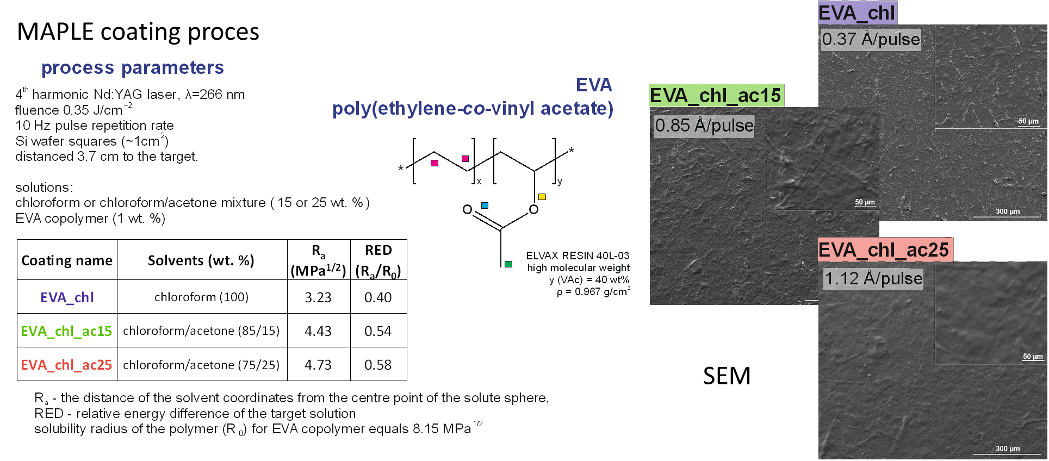
Solvent/non-solvent-based approach in MAPLE deposition of EVA coatings

Slide 3
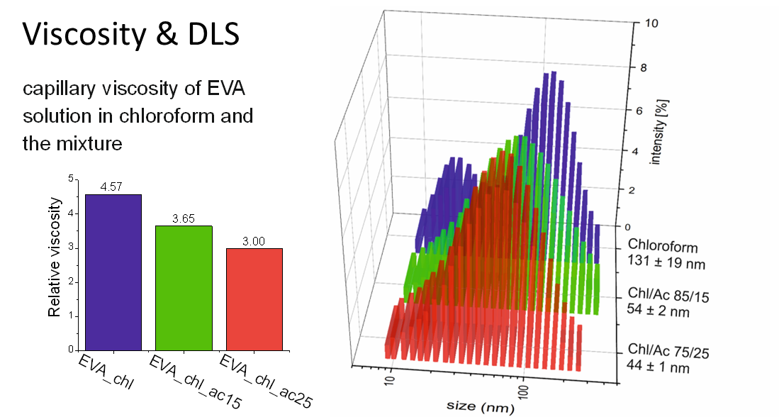
Solvent/non-solvent-based approach in MAPLE deposition of EVA coatings
Comparing three 1 wt% EVA target solutions, it is clear that the addition of acetone led to a significant viscosity reduction: about 1/5th reduction for the solution with 15 wt% acetone, and about 1/3rd for 25 wt% acetone. Such a substantial change in the rheological properties of the EVA solution confirms the presumptions regarding the spatial conformation of EVA macromolecules induced by the presence of acetone – the non-solvent and is in line with the calculated solubility parameter (RED) values.
The size distribution and the Z-average value of the EVA molecules shifts to lower values as more acetone is added to the solution. In pure chloroform, the Z-average is more than two times higher than for mixtures with acetone. Since the EVA macromolecules occupy less volume in the solution, their entanglement with other molecules and intermolecular interactions are also diminished. This reduces the internal friction between the macromolecules, and between the macromolecules and surrounding solvent molecules. This results in a lowering of the solution viscosity.

Slide 4
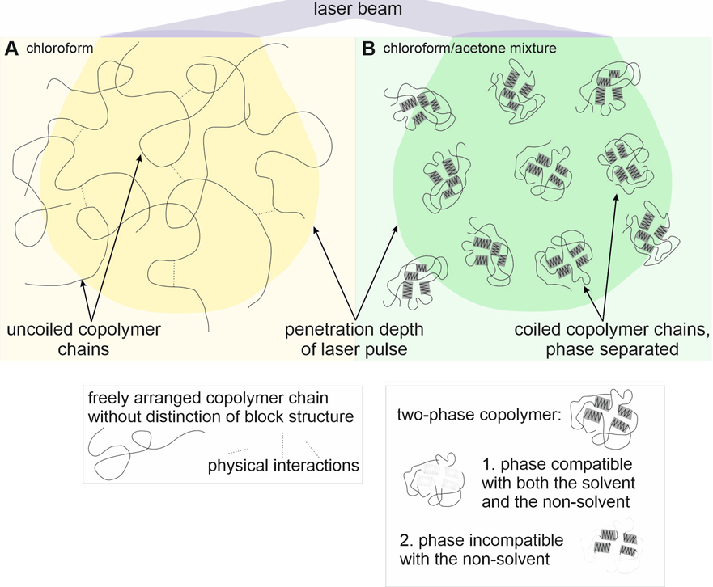
Solvent/non-solvent-based approach in MAPLE deposition of EVA coatings
Conclusions
The addition of non-solvent to the target solution significantly increases the deposition rate of EVA coating by MAPLE. A higher acetone content (non-solvent) resulted in a higher deposition rate. Additionally, the coatings obtained were characterized by an excellent chemical structure preservation. It is hypothesized that the non-solvent addition influences the spatial conformation of EVA copolymer, decreasing the volume occupied by macromolecules and therefore reducing their entanglement in the solution. As such, macromolecules are expected to undergo less scission upon laser irradiation of the target and the laser energy is predominantly used for the material removal rather than for degradation of the molecular chains, with a direct accountability in the deposition efficiency. This increases 3 times upon using 25% acetone in the matrix with respect to pure chloroform one.
The addition of acetone leads to the formation of semicrystalline areas within the coatings, which were not observed for processes with pure chloroform used as target solution. The size of these areas depends on the amount of the non-solvent in the target solution. They are larger for the solution with 15 wt% of acetone and much smaller for 25 wt% of acetone. This effect can be attributed to a phase separation of EVA macromolecules due to the fact that acetone is a polar solvent compatible only with one part of EVA chain i.e., VAc unit.

